Slide 1
Hybrid CNN-SVM model for Action
Recognition from Videos
Submitted By :-
Name:-Anik Mitra (10200119064)
Name:-Uttam Modi (10200119058)
Name:-Pratik Tamang (10200119066)
Name:-Rahul Pramanik (10200119061)
Under the guidance of
Dr.Kousik Dasgupta
Computer Science and Engineering
Kalyani Government Engineering College

Slide 2
CONTENTS
Introduction
Literature survey
Proposed Work
A Proposed Convolution Neural Network with LSTM model
A Novel framework using CNN with Support Vector Machine( SVM)
Model Investigation
Comparative analysis
It’s applications and output
Conclusion

Slide 3
INTRODUCTION
Action recognition is the task of identifying an action in a video by Neural Network or Artificial Intelligence model.
Goal: To train a Artificial Intelligent Model that can analyze a video and able to predict what action is taking place with efficiently and good accuracy.
Input Video
MODEL
Prediction, eg: Playing Guitar, Playing Violin.

Slide 4
LITERATURE SURVEY
[1] The author developed a deep convolutional network armature for detecting mortal conduct in videos by using the action bank features of the UCF50 database.
[2] the author established 3D CNN models for action recognition .These models develop features from both spatial and temporal measurements by performing 3D convolutions
[3] The author analyzes mortal action recognition as being a grueling task due to both the spatial and temporal confines of the action data.

Slide 5
PROPOSED MODEL
Dataset
CNN(Convolutional Neural Network) + LSTM (Long Short Term Memory)
CNN(Convolutional Neural Network) + SVM(Support Vector Machine).
Libraries
Keras
Tensorflow
UCF-101

Slide 6
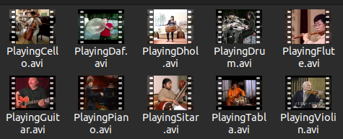
DATASET CLASSES
UCF101 dataset is an extension of UCF50.
Categories of UCF101.
Total video hours of Dataset .
FPS & resolution of the videos.
Playing Cello, Playing Guitar Playing Dhol, Playing Flute, Playing Piano, Playing Sitar, Playing Tabla' Playing Violin, Playing Daf, Drumming

Slide 7
PREPROCESS OF DATA
We resize the frames of the videos to a fixed width and height.
To reduce the computations and normalize the data to range.
The range will be [0-1] by dividing the pixel values with 255, which makes convergence faster while training the network.
We have taken the number of frames of a video that will be fed to the model as one sequence will be 20 so that we get the whole idea of what is happening in the video.
Frame Extraction
Data normalization

Slide 8
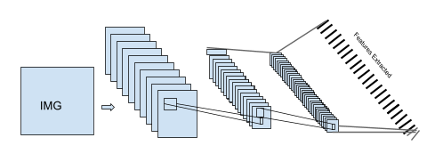
CONVOLUTIONAL NEURAL NETWORK
Architecture of Convolutional Neural Network
Convolutional Layer:
Pooling Layer:
Fully-Connected layer:
CNN is a neural network that extracts spatial features

Slide 9
LONG SHORT TERM MEMORY (LSTM)
It work very well in sequential data like audio, video and text.
LSTM used for Classification problems.
LSTM models with Convolutional Neural Networks excel at learning spatial relationships.

Slide 10
Proposed HYBRID CNN WITH LSTM model
We have used time-distributed Conv2D layers which will be followed by MaxPooling2D.
The feature extracted from the Conv2D layers will be then flattened using the Flatten layer and will be fed to a LSTM layer.
The Dense layer with softmax activation will then use the output from the LSTM layer to predict the action being performed.

Slide 11
SVM(Support Vector Machine)
Support Vector Machines(SVM) is considered to be a classification approach but it can be employed in both types of classification and regression problems.
It’s a supervised learning algorithm that is mainly used to classify data into different classes.
SVM segregate the given dataset in the best possible way.
In our model for cnn+svm features from CNN fed into SVM algorithm for video classifier we use loss function ‘ squared hinge’ for multiple classes and activation function ‘softmax’.
y
x
SVM

Slide 12
A NOVEL CNN + SUPPORT VECTOR MACHINE(SVM) APPROACH FOR ACTION RECOGNITION IN VIDEOS
SVM
input
Sequence
Model
Max Pooling Layers
CNN with different filter size

Slide 13
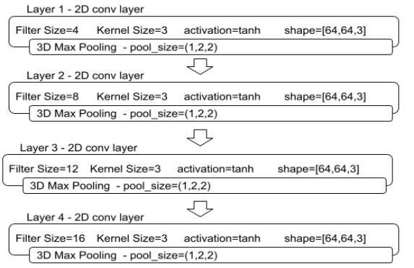
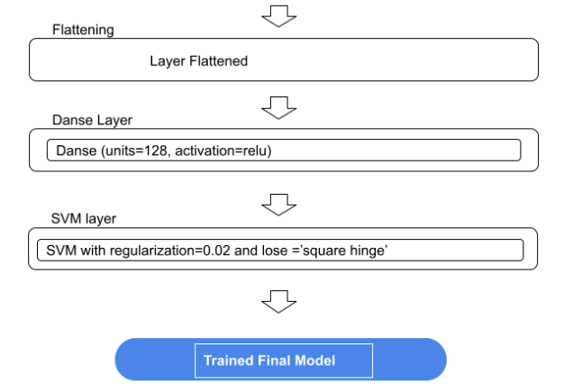
The LAYERS OF FINAL CNN + SVM MODEL

Slide 14
DIFFERENCE BETWEEN SVM AND LSTM AS CLASSIFIER
Structure: SVM possesses a number of parameters that increase linearly with the linear increase in the size of the input. LSTM, on the other hand, doesn’t.
Required of Training Data: Support vector machines effectively use only a subset of a dataset as training data. Which reduces the training data, in turn, LSTM requires huge training dataset.
Training time for Algorithm: SVMs are generally very fast to train, while lstm is slow.

Slide 15
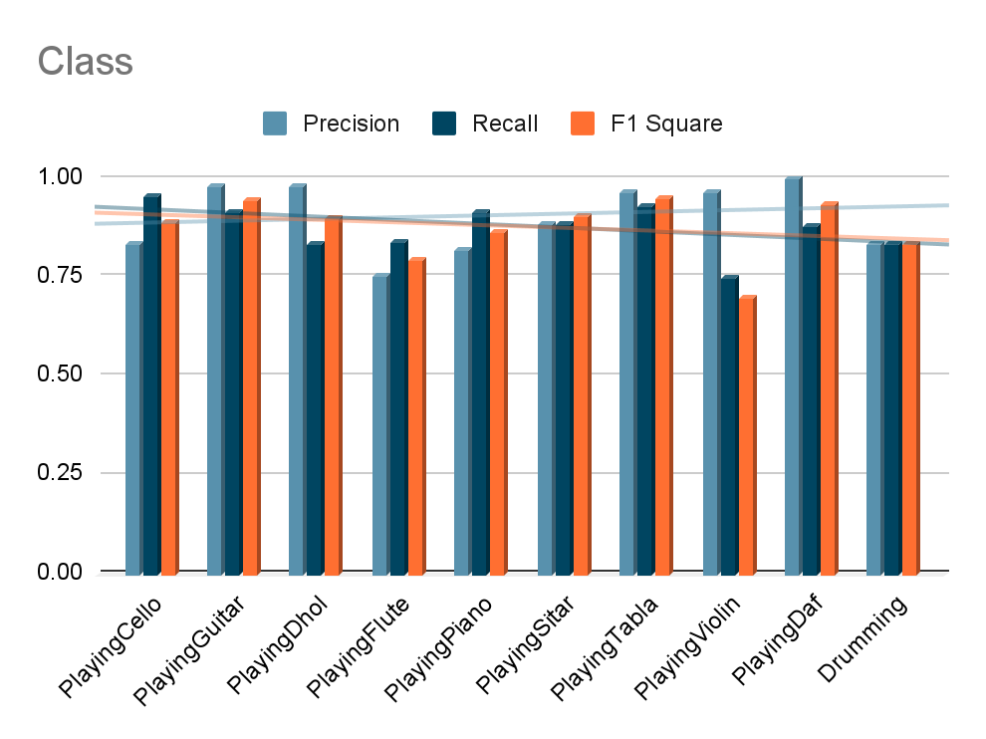
RESULT AND ANALYSIS
Accuracy - 0.8834
Loss - 0.9492
Precision_Score - [0.83333333, 0.98181818, 0.98076923, 0.75609756, 0.82051282, 0.88372093, 0.96551724, 0.65217391, 1. , 0.83333333]
Recall_Score - [0.95744681, 0.91525424, 0.83606557, 0.83783784, 0.91428571, 0.88372093, 0.93333333, 0.75 , 0.88235294, 0.83333333]
F1_Score - [0.89108911, 0.94736842, 0.90265487, 0.79487179, 0.86486486, 0.9047619 , 0.94915254, 0.69767442, 0.9375 , 0.83333333]

Slide 16
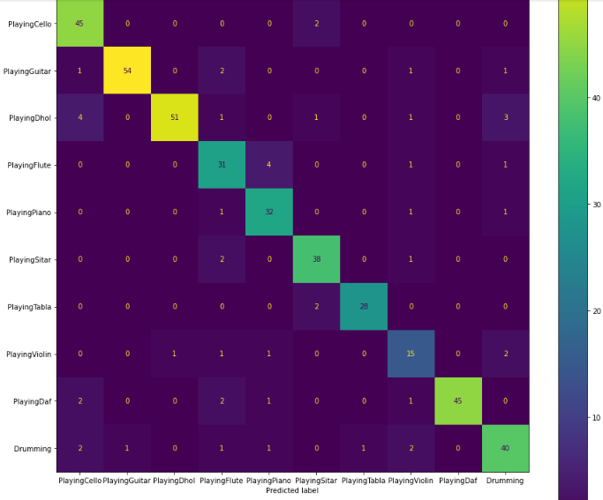
CONFUSION MATRIX OF OUR PROPOSED MODEL

Slide 17
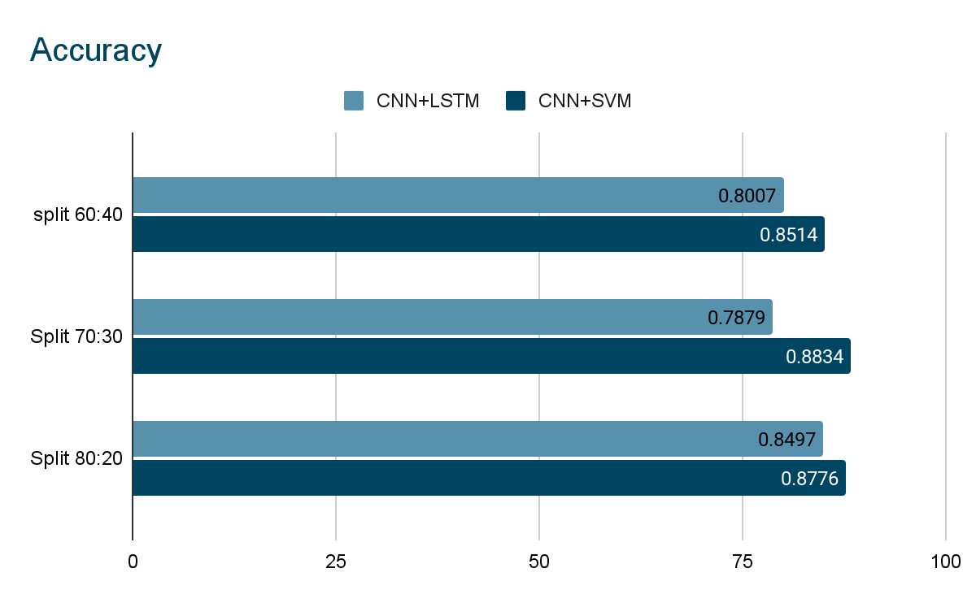
PERFORMANCE EVALUATION OF THE PROPOSED METHOD WITH OTHER METHODS BASED ON SPLIT RATIO.

Slide 18
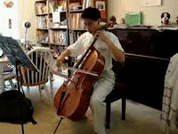

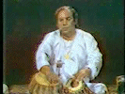
PREDICTED OUTPUT GENERATED

Slide 19
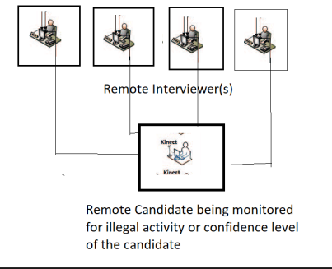
APPLICATION OF PROPOSED WORK
In our Model we have taken some music related classes where we can identify what instrument the person is playing or trying to play.
The applications range from surveillance in Industry line, online interview for job aspirants or may be Cheating on the Seat of The Examination.
The presented work is a part of a surveillance system for remote online based Interview systems to facilitate recruiters.

Slide 20
CONCLUSION
We carried out a brief study of Hybride CNN-SVM Model for Action Recognition from videos and proposed some experiments on it.
We took the UCF101 dataset and with the 10 classes/categories.
Preprocessed the dataset and took out the features from the series of images using CNN.
Splitted the dataset into various split ratio like 60:40 , 70:30 and 80:20.
For the Classification of actions we used LSTM and gained an accuracy of 78.9 % with 70:30(standard split ratio).
Furthermore, for better classification we moved to CNN with Support Vector Machine(our Proposed model) from LSTM with an accuracy of 88.34 %

Slide 21
FUTURE SCOPE
Action Recognition is an important problem in computer vision. AR is the basis for many applications such as video surveillance, health care, and human-computer interaction. Methodologies and technologies have made tremendous development in the past decades and have kept developing up to date. However, challenges still exist when facing realistic sceneries.

Slide 22
REFERENCE
[1] S.Sadanand and J.Corso,“Action bank: A high-level representation of activity in Video,” IEEE Computer Society Conference on Computer Vision and Pattern Recognition ,pp. 1234-1241. 2012.
[2] Shuiwang Ji, Wei Xu, Ming Yang, and Kai Yu ,“3D convolution neural networks for human action recognition”, IEEE Transactions On Pattern Analysis And Machine Intelligence , vol. 35, no. 1,pp. 221-231, 2013.
[3] Meng Li, Howard Leung, and Hubert P. H. Shum,“Human action recognition via skeletal an depth based feature fusion,”Proceedings of the 9Th International Conference on Motion in Games,pp.123-132, 2016
[4] 1 Jeevan J.Deshmukh, 2Nita S.Patil, 3Dr.Sudhir D.Savarkar 1Student, 2 Assistant Professor, 3Professor of the IEEE, ISSN: 2321-9939.
[5] Yuanyuan Huang, Haomiao Yang,and Ping Huang, “Action recognition using hog features in different resolution video sequences,” International Conference on Computer Distributed Control and Intelligent Environmental Monitoring, 2012.
[6] Heng Wang, Alexander Klaser, Cordelia Schmid,and Cheng-Lin Liu,“Dense trajectories and motion boundary descriptors for action recognition,”International journal of computer vision,pp.60-79,2013.
[7] Jilin Communications Polytechnic, Changchun, pp.117-126.
[8] TamV.Nguyen et al.,“Spatial-Temporal Attention-Aware Pooling for Action Recognition,” IEEE Transactions On Circuits And Systems For Video Technology, vol. 25, no. 1,pp.77-86, 2015.

Slide 23
Thank you !

